Slide 1
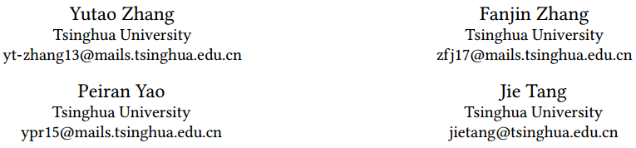
Name Disambiguation in AMiner: Clustering, Maintenance, and Human in the Loop

Slide 2







identity constraint
pairwise constraint

Slide 3
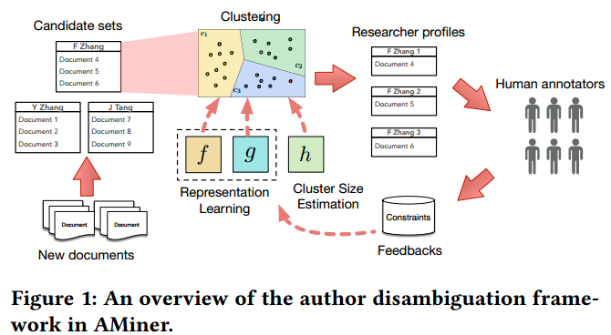

Slide 4
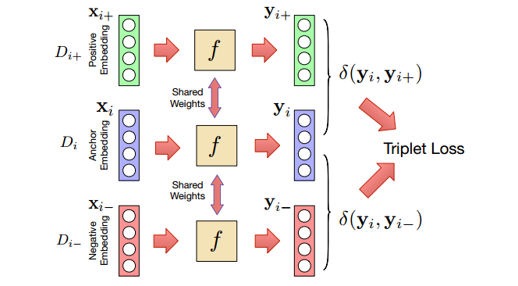

Representation Learning
Global Metric Learning

Slide 5
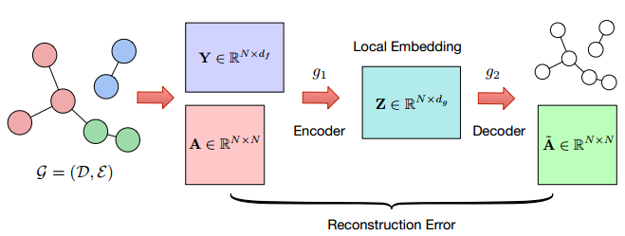

Representation Learning
Local Linkage Learning

Slide 6
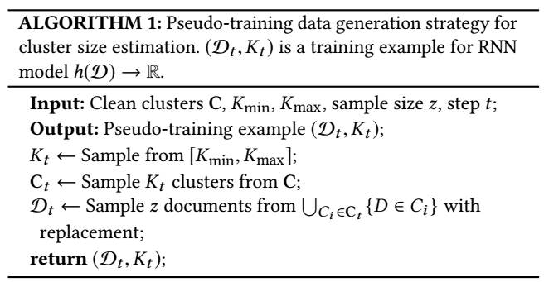

Cluster Size Estimation

Slide 7
Continuous Integration
Real-time Update
Data Consistency
Human in the Loop
(1)Delete
(2) Insert
(3) Split
(4) Merge
(5) Create
(6) Confirm

Slide 8
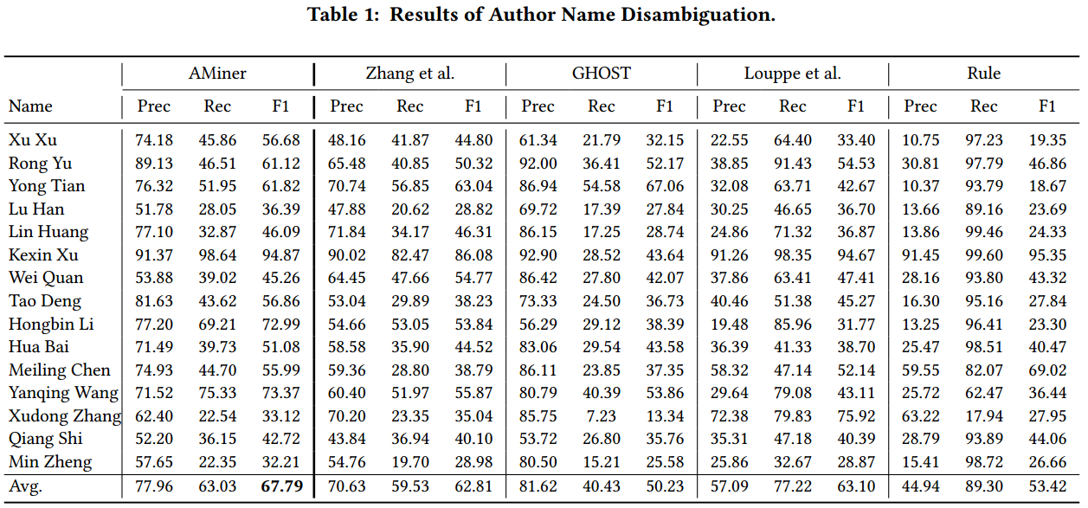

Slide 9
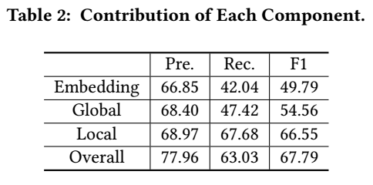

Slide 10
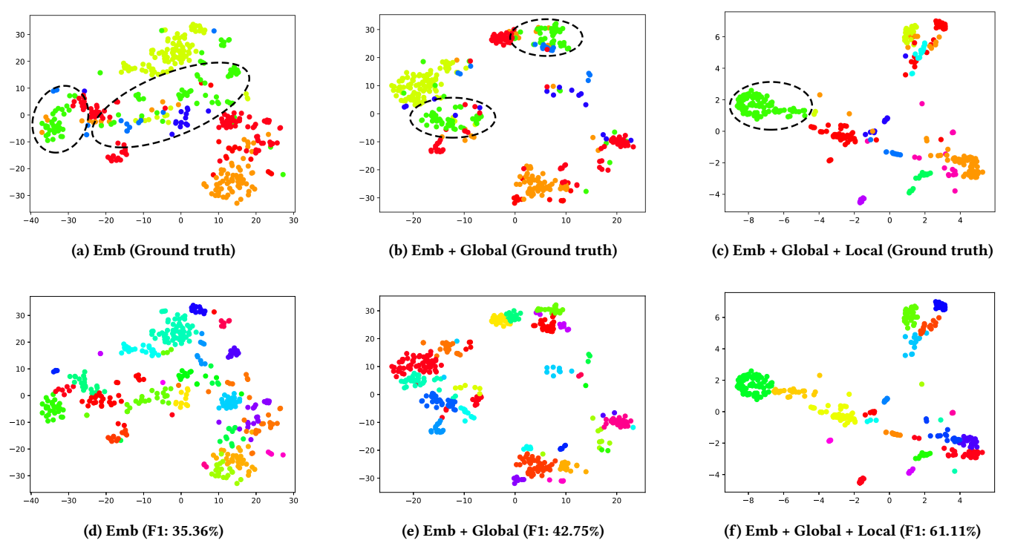
Notes:
Figure 4: t-SNE Visualization of embedding spaces on a candidate set. Each color in (a), (b), (c) denotes an individual ground truth cluster, while each color in (d), (e), (f) denotes a predicted cluster by hierarchical agglomerative clustering. Emb indicates the original feature embedding. Global and Local represent the use of global metric learning and local linkage learning respectively. The dashed black ellipses in (a), (b), (c) circle the points of the same ground truth cluster.

Slide 11
